Slide 1

TEAM NAME :- TECH BUSTERS
TEAM MEMBERS :-
VEDANT PATIL
SHLOK ANGLE
AMIT MARATHE
TEJAS PATIL

Slide 2

PROBLEM STATEMENT
Movies
One trailer per movie doesn't quite cover everyone's favorite parts. Can AI generate trailers with different highlights for varying demographic needs?

Slide 3
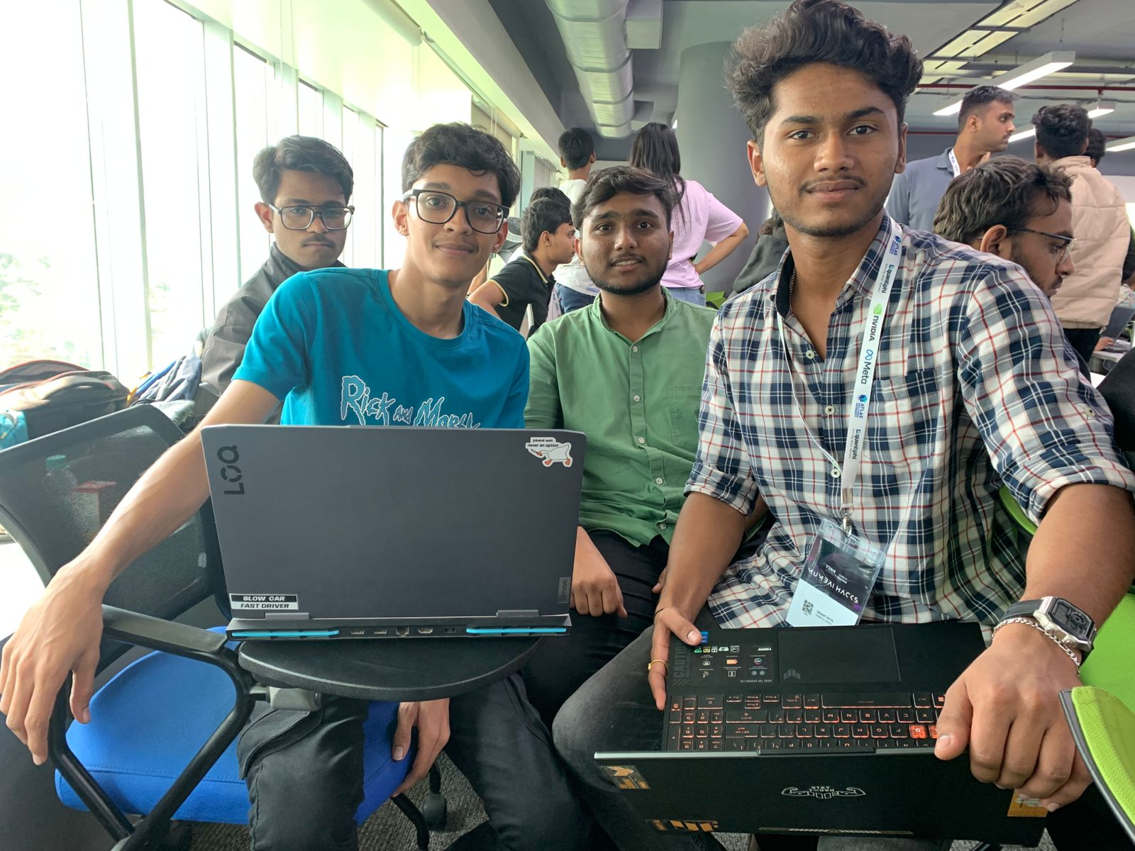

Slide 4
The website will ask the user to upload a video file.
The uploaded video file will then be converted into jpg frames.
The frames will then be categories into various classes such as action films, kids content etc.
The user will be prompted to enter age and gender to cater the trailer generation ai
According to the entered age the ai will select the scenes from the video and generate a trailer appropriate to that age group and gender

Slide 5


